Slide 1

Music & Movie Group
Anthony Gruber, Avery Peiffer, Samir Sherlaker, Carter Smith

Slide 2
Problem Statement
“What movie should I watch?”
Too much content to reasonably watch, spread over dozens (and counting) of streaming services
General recommendations will be useless if the recommended movies are hosted on a platform you do not subscribe to
Filter movies based on the streaming platforms that you use to receive useful, personalized recommendations

Slide 3

Importance
CrossFilmz is heavily inspired by the website agoodmovietowatch.
agoodmovietowatch relies on human-curated recommendations rather than the decisions of a massive algorithm. Of course, there are benefits to this, but we all know the main drawback with it...
IT’S NOT SCALABLE!

Slide 4
Functional Requirements
User login page User account registration page Search bar for finding movies Display Movies as a Responsive Grid User profile containing previous ratings | Generate list of recommendations Filter based on streaming service Filter based on genre or other attribute ‘More info’ link when clicking on each movie Ability to add a movie rating out of five stars

Slide 5
Non Functional Requirements
3.5.1 Performance
The time from movie search to the time movies are rendered on the grid below should be under 1000ms
3.5.2 Reliability
After system failure, the system will retrieve last saved state for the user
3.5.3 Availability
System downtime may not exceed one minute per day
3.5.4 Security
System should use one OAuth endpoint for logins to minimize attack surface
3.5.5 Maintainability
Deploy changes in one commit accomplished via Github Actions
Mean Time to Change (MTTC) for defects is less than 3 days
3.5.6 Portability
The website works on a variety of browsers, including Google Chrome and Firefox
The website also maintains layout on mobile and web browsers
3.5.7 Documentation
The source code is documented by putting method comments in class docstring above each class

Slide 6
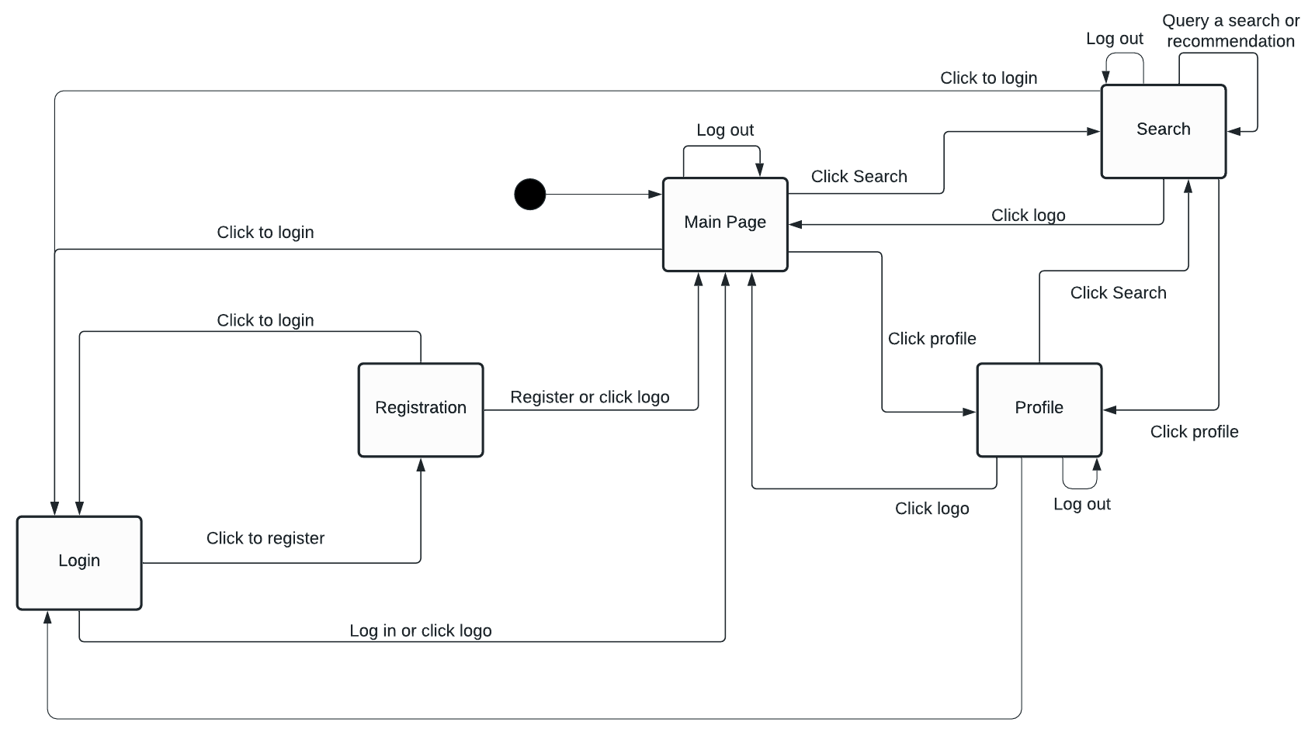
State Diagram
Click to login

Slide 7
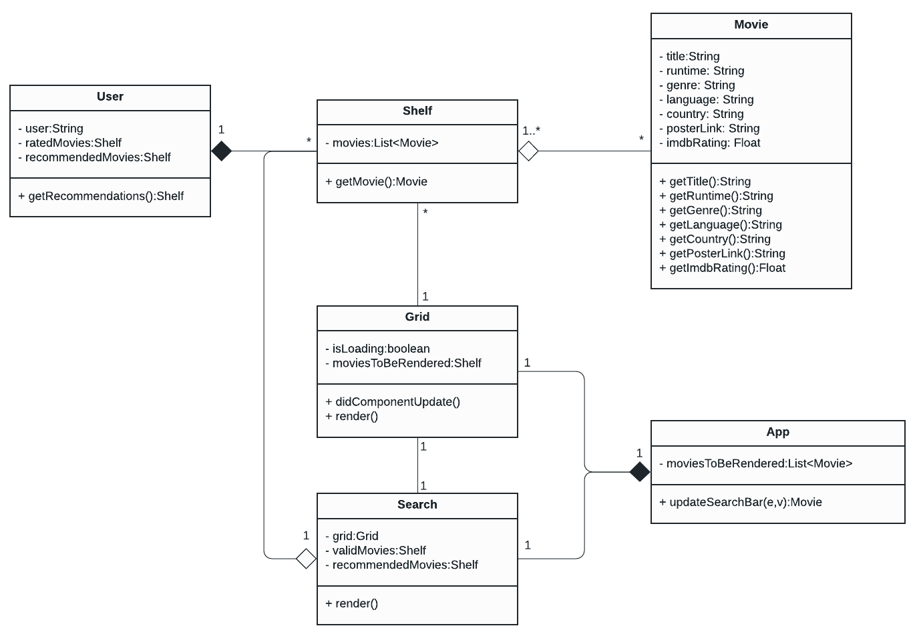
Class Diagram
Notes:
Shelf cant exist without user

Slide 8



Tech Stack
Client: ReactJS
Database/Hosting: GCP
Server: Flask

Slide 9
Key Challenges
Working remotely in an Agile/SCRUM workflow
Learning new technologies (ReactJS, GCP, Flask, APIs)
Developing a testing suite
Setting up interface with OAuth Server for secure login
Relating the database to OAuth logins
Updating our documentation effectively (SRS, Trello)

Slide 10
Image Citations
agoodmovietowatch logo: agoodmovietowatch.com
Google Cloud Platform logo: https://www.google.com/url?sa=i&url=https%3A%2F%2Fwww.sinefa.com%2Fintegrations%2Fgoogle-cloud%2F&psig=AOvVaw2xBNLndREUYWZnwJkfd0nH&ust=1591810540319000&source=images&cd=vfe&ved=0CAIQjRxqFwoTCPDn08Ci9ekCFQAAAAAdAAAAABAD
ReactJS logo: https://www.google.com/url?sa=i&url=https%3A%2F%2Fcommons.wikimedia.org%2Fwiki%2FFile%3AReact-icon.svg&psig=AOvVaw3Yk1fhxIwL3mOp7lYUXish&ust=1591810614024000&source=images&cd=vfe&ved=0CAIQjRxqFwoTCOCms-Wi9ekCFQAAAAAdAAAAABAD
Flask logo: https://www.google.com/url?sa=i&url=https%3A%2F%2Fwww.brandeps.com%2Flogo%2FF%2FFlask-01&psig=AOvVaw20a3dsxFebCJ7lEs2Feori&ust=1591810658783000&source=images&cd=vfe&ved=0CAIQjRxqFwoTCOC46_qi9ekCFQAAAAAdAAAAABAD

